Slide 1



DOTNETMASTERY
The ultimate learning recourse for .NET developers.

Slide 2
What is this course about?

Slide 3
Why this course?

Slide 4





Slide 5
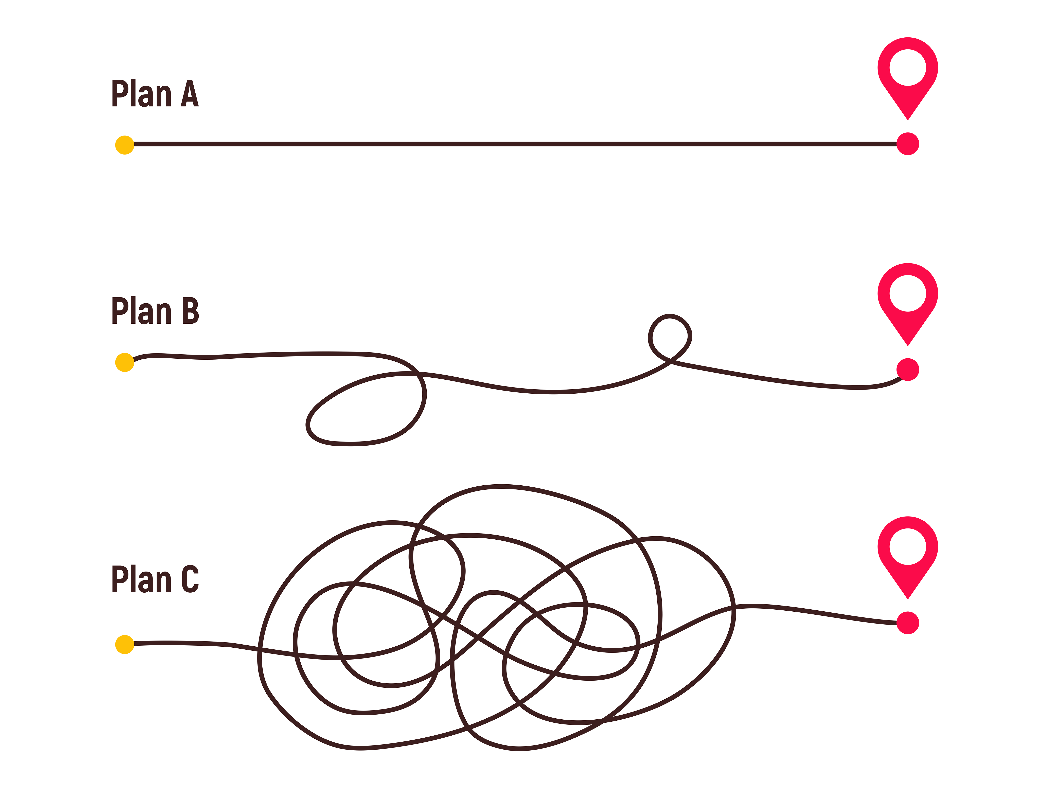
My learning curve!

Slide 6
Your Journey
NOT!

Slide 7
Your Journey!

Slide 8

.NET
JAVA

Slide 9
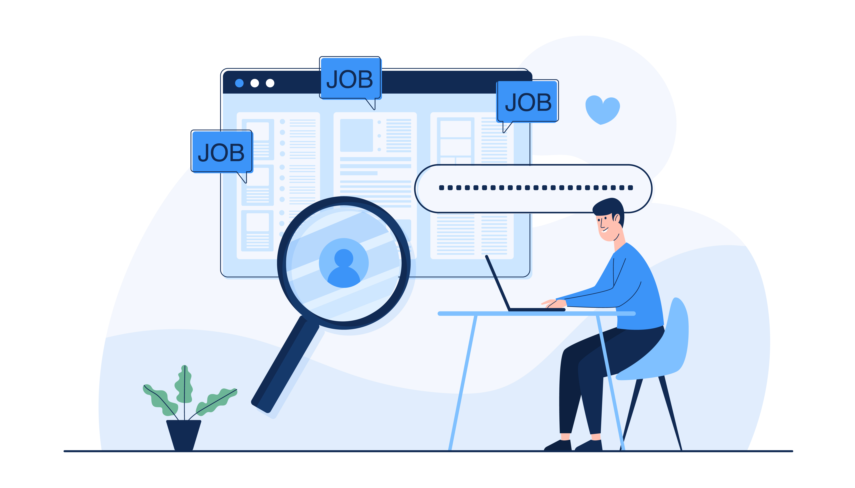

Best Practices
Real World Examples

Slide 10
9 Projects
25 Assignments

Slide 11
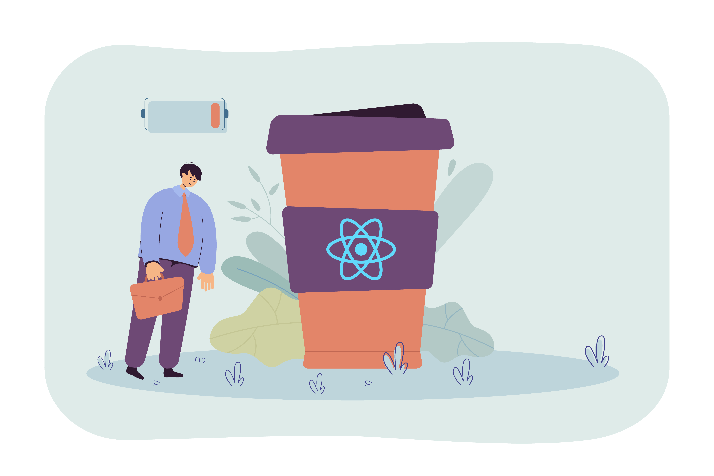

Slide 12
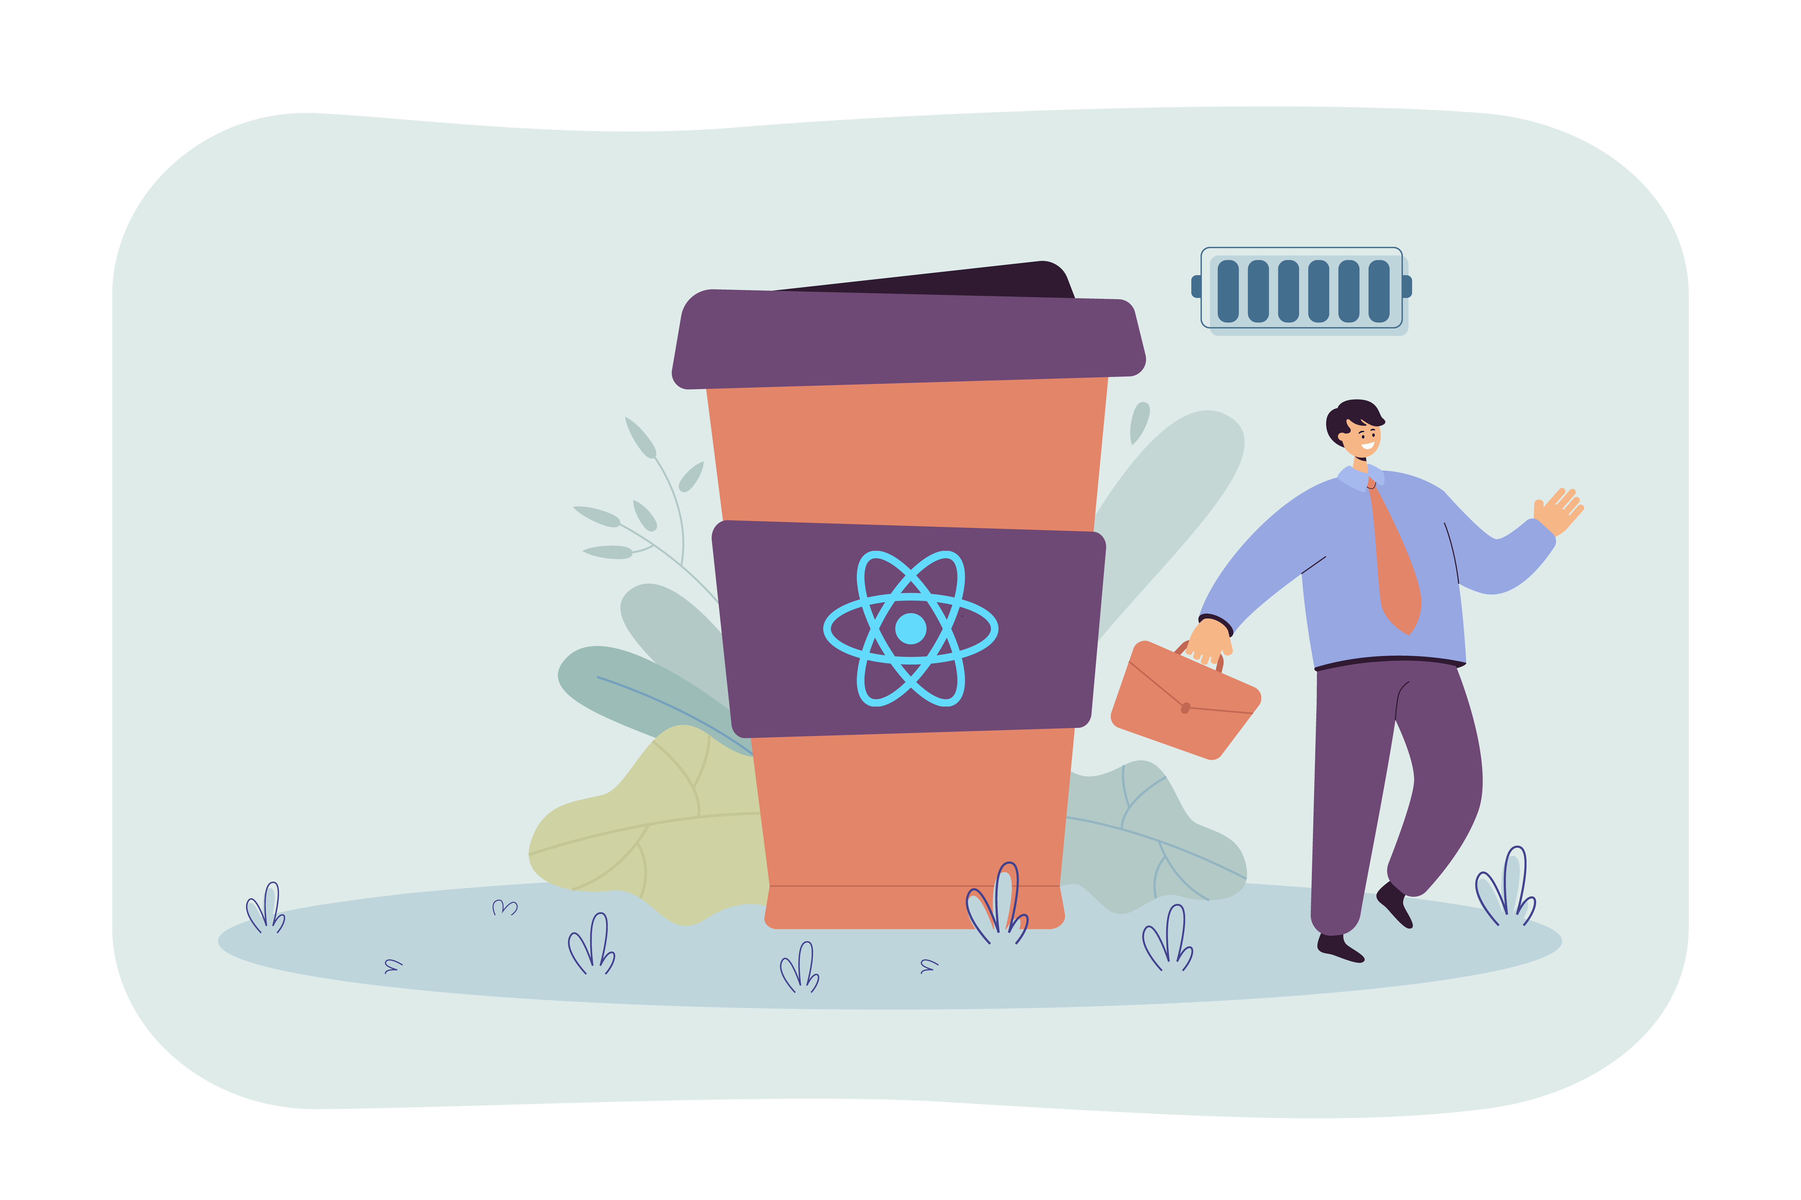

Slide 13
DOTNETMASTERY
The ultimate learning recourse for .NET developers.

Slide 14
What is React?

Slide 15
What is React?

Slide 16
Create React App

Slide 17
What is React?
React is Front End Javascript Framework
React is Declarative
React is Composable / Component based
React is FAST!
Maintained by META
React is responsible for maintaining/managing the UI Aspect.

Slide 18
Tools Needed
Visual Studio Code
Node JS
Visual Studio 2022
SQL Server Management Studio
Azure Subscription

Slide 19
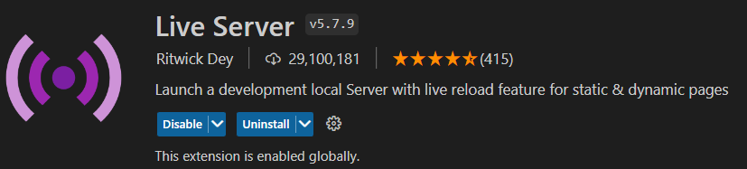
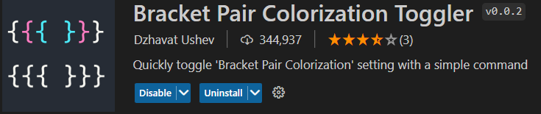
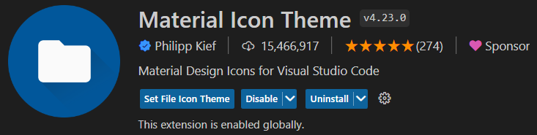
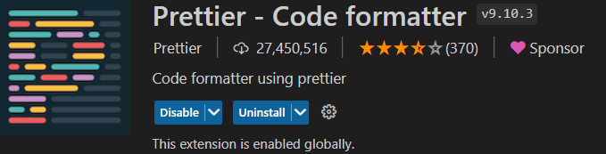
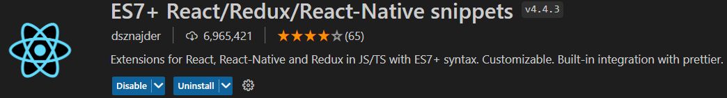
Visual Studio Code Extensions

Slide 20
How to get Help?

Slide 21
Section 2

Slide 22
Section 3

Slide 23
Section 4

Slide 24
Section 5

Slide 25
Section 6

Slide 26
Section 7

Slide 27
Section 2

Slide 28
Section 2

Slide 29
npx json-server --watch data/traveldb.json --port 5001
Start json-server

Slide 30
Section 2

Slide 31
Class vs Functional Components
Class Components
Functional Components
Less common
render() method is required, which returns an HTML element
Stateful components
Class components have lifecycle methods
More common
render() method is not present, it directly returns HTML element or nothing.
Stateless components
Class components do have lifecycle methods
Hooks!

Slide 32
JSX Components
Component Names must be Pascal Casing
Props must be camel casing
Inline style is an object so it must be enclosed in double curly brackets
Integer in props will go in {} and “” will be string , and bool goes in {}
‘class’ needs to be replaced with ‘className’

Slide 33
RTK Query
Queries – used to fetch data (Get/GetALL)
Mutation – used to update data (Create/Update/Delete)

Slide 34
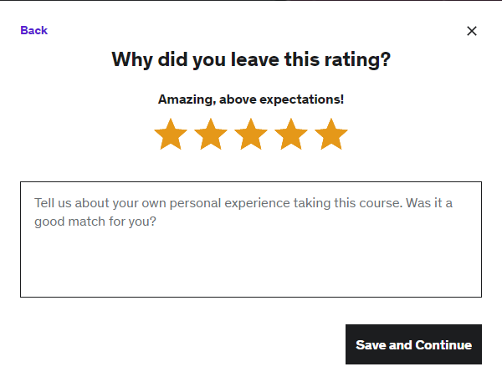
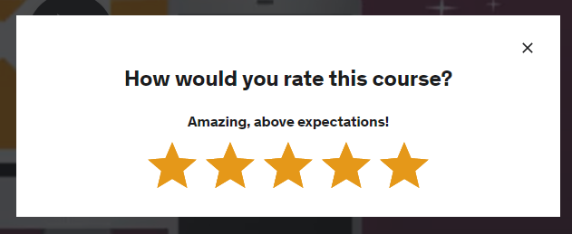
Reviews
dotnetmastery@gmail.com

Slide 35
Feedback
dotnetmastery@gmail.com

Slide 36
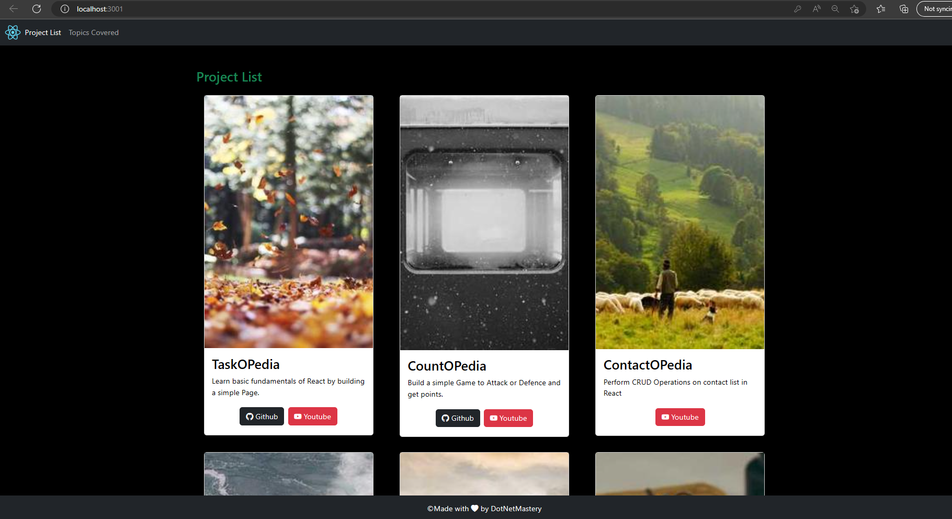
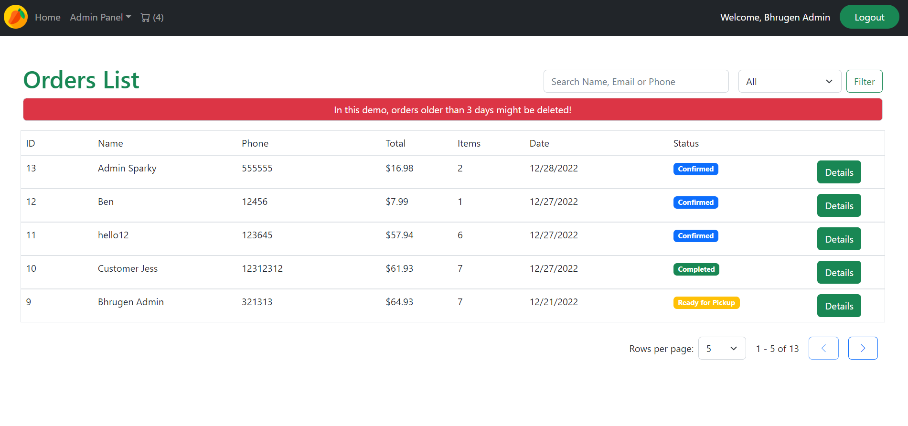
Bonus Content

Slide 37


My code doesn’t work!
Code works, but I am confused
Google it!
Check Q&A Section
POST a queston (with Git branch)
Google it!
Message me on udemy!

Slide 38
My code doesn’t work!
Code works, but I am confused
Google it!
Check Q&A Section
POST a queston (with Git branch)
Google it!
Message me on udemy!

Slide 39
Prerequisites
Basic programming experience
HTML / CSS / JS Familiarity
.NET API CRUD Operations (.NET Core & EF Core)

Slide 40
Reviews

Slide 41
Azure Deployment

Slide 42
Project Resources

Slide 43
JSX

Slide 44
Projects Built
TaskOPedia -
CountOPedia
ContactOPedia
LifeCyclOPedia
WatchOPedia
RouteOPedia
ReduxOPedia
TravelOPedia
Red Mango

Slide 45
What we will learn
React Fundamentals
TypeScript
Redux Toolkit & RTK Query
Routing in Redux
Axios
Stripe Payment in React
Authentication and Authorization in React
File Management in React

Slide 46

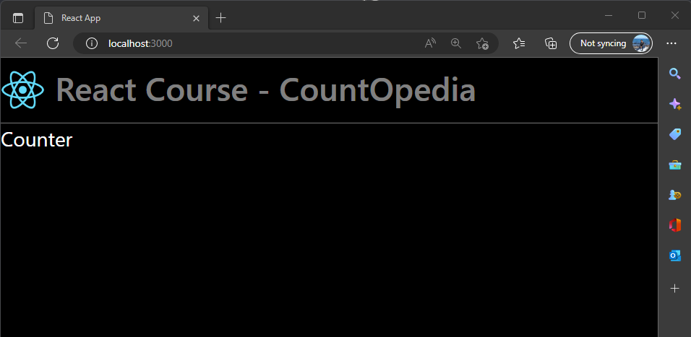
Assignment 7 – CountOPedia Setup
Remove all files other than index.html, index.js and react Image
Move react image to src/images folder. (Create images folder)
Clean index.js and index.html (Remove anything that is not used)
Add Bootstrap js/css CDN inside index.html
Create 2 components (Design to look as shown in image)
Header.jsx (Functional Component)
Counter.jsx (Class Component)
Copy the images provided in course snippet section 4 to the images folder

Slide 47
Class Component Lifecycle Methods
ComponentDidMount
Runs after the component has been rendered to DOM
ComponentDidUpdate
Runs after a component is updated.
It is not executed when component is rendered for the first time.
ComponentWillUnmount
Runs after a component is unmounted.
Ideally used for cleanup operations

